Slide 1
Cellular Network- 1G
Goal: To develop a working system that could provide basic voice service
Time frame: 1980s
Technology: FDMA/FDD
Speed: 2.4Kbps
1G network used Analog signal
Example Systems:
Advanced Mobile Phone System (AMPS-USA)
Total Access Communication System (TACS-UK)
Nordic Mobile Telephone (NMT-Europe)

Slide 2
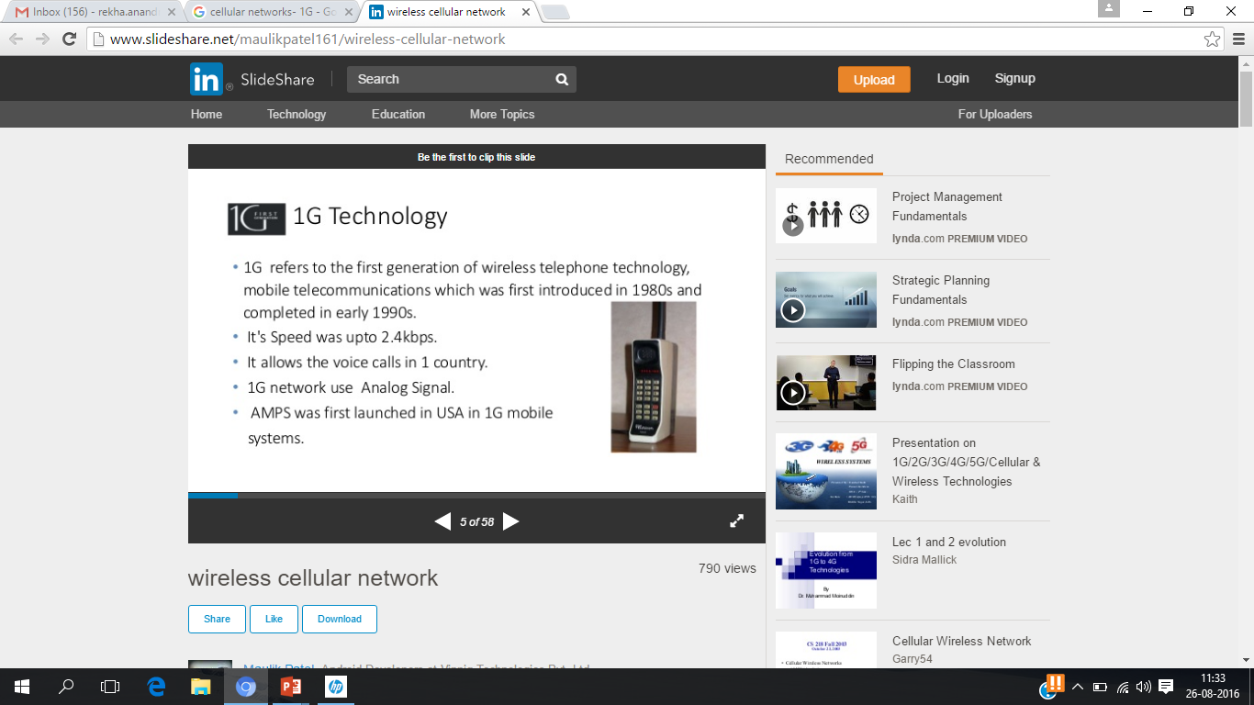
Draw backs of 1G
Poor voice quality
Poor battery life
Large phone size
Limited capacity
Poor handoff reliability

Slide 3
Cellular Network-2G
Goal: Digital voice service with improved quality and also provide better services
Time Frame: Launched in Finland in 1991
Used digital signals
Digital modulation formats were introduced in this generation with the main technology as TDMA/FDD
Data Speed: upto 64kbps
Services like text message, picture message was included.
Example Systems:
Global System for Mobile Communications (GSM) (TDMA and FDMA)
IS-95(Interim Standard) (CDMA)

Slide 4
Cellular Network- 2.5G
Goal: To provide better data rates and wider range of data services and it was a transition from 2G to 3G
Time frame: 2000-2002
Features
Phone calls
Send/receive e-mail
Speed: 64-144kbps
Camera phones
Example Systems:
General Packet Radio Service (GPRS)
Enhanced Data rates for GSM Evolution (EDGE)

Slide 5
Drawbacks of 2G
Requires strong digital signals to help mobile phones work. If there is no network coverage in any specific area, digital signals would be weak.
2G The GSM is a circuit switched, connection oriented technology, where the end systems are dedicated for the entire call session. This causes inefficiency in usage of bandwidth and resources.
The GSM-enabled systems do not support high data rates.
They are unable to handle complex data such as video.

Slide 6
Cellular Network- 3G
Goal: High speed wireless data access
3rd Generation Partnership Project (3GPP) is the standard
Technology used: TD- CDMA
Enhanced data rates of 2- 20Mpbs
Service flexibility
Global roaming across networks
Improved security

Slide 7
3G Applications
3G mobile is the major opportunity for business, commerce and consumers
Higher bandwidth enables a range of new applications.
For the consumer
 Video seamless roaming, TV broadcast
 Video calls, video clips – news, music, sports
 Enhanced gaming, chat, location services…
For business
 High speed teleworking / VPN access
 Sales force automation
 Video conferencing
 Real-time financial information

Slide 8
Cellular Network- 4G
Goal:
High mobility, High data rate
Frequency Band: 2 to 8 Ghz.
Download speed is upto 100 Mbps for moving users and 1GPS for stationary users.
LTE (Long Term Evolution)
Uses Orthogonal Frequency Division Multiplexing (OFDM)
Uses Multi-input Multi-output(MIMO) for enhanced throughput

Slide 9
Features of 4G
Support for interactive multimedia, voice, streaming video, Internet, and other broadband services
• Fully IP based mobile system
• High speed, high capacity, and low cost‐per‐bit
• Global access, service portability, and scalable mobile services
• Seamless switching, and a variety of Quality of Service
• Better scheduling and call‐admission‐control techniques
• Better spectral efficiency
• Interoperability with existing wireless standards
• Packet switched network

Slide 10
Advantages of 4G
Affordable communication services.
High speed, high capacity and low cost per bit.
Support for interactive multimedia, voice , streaming video, Internet and other broadband services.
Global access, Service portability and scalable mobile services and variety of quality of services provided.
Better spectral efficiency.
seamless network of multiple protocol and air interfaces.

Slide 11
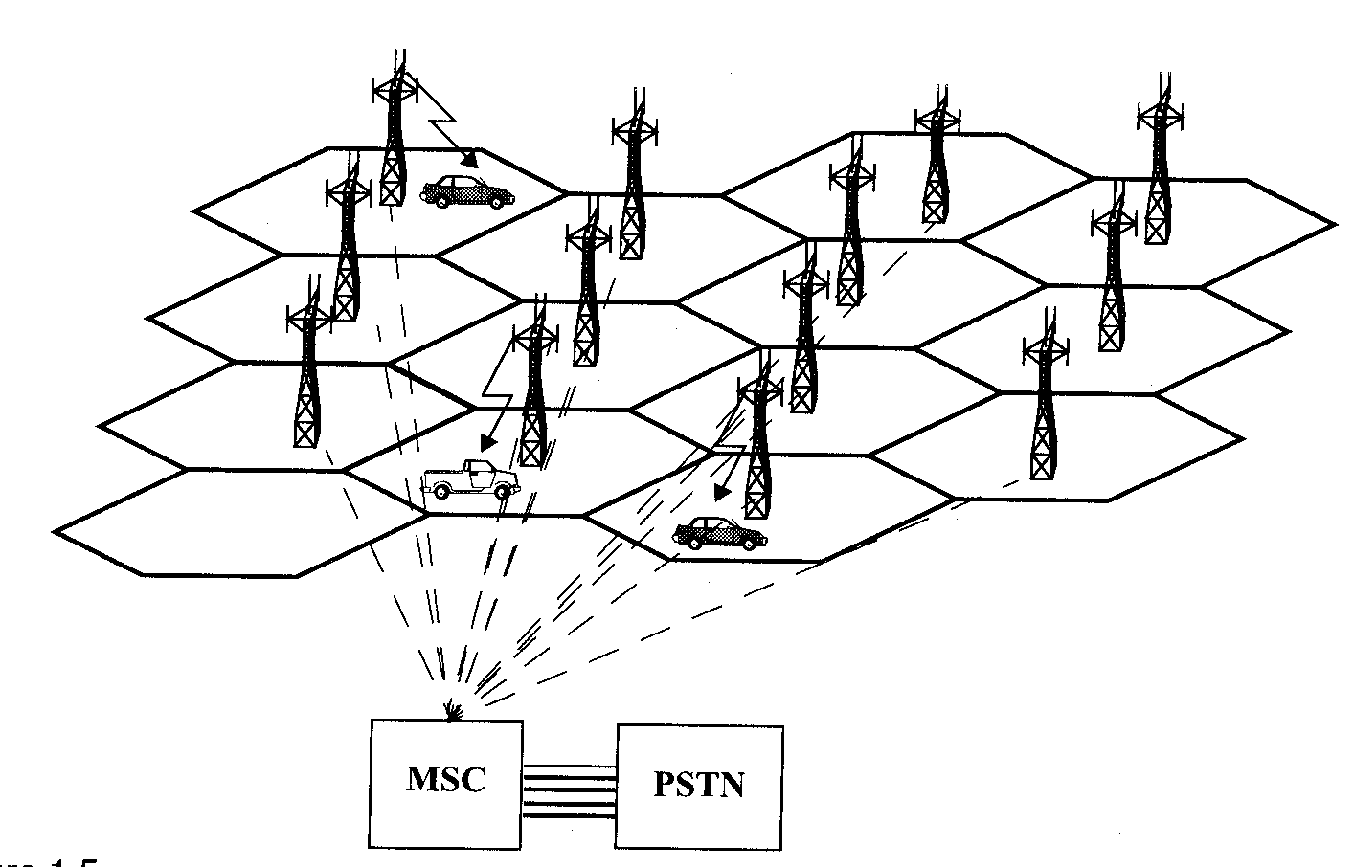
Example of Wireless Communication- Cellular Telephone Systems
Fig: A cellular system
Courtesy to Theodore S. Rappaport
©2002, 1996 Prentice Hall PTR

Slide 12
Example of Wireless Communication- Cellular Telephone Systems
Communication between the base station and mobiles is defined by the standard Common Air Interface (CAI)
forward voice channel (FVC): voice transmission from base station to mobile
reverse voice channel (RVC): voice transmission from mobile to base station
forward control channels (FCC): initiating mobile call from base station to mobile
reverse control channel (RCC): initiating mobile call from mobile to base station

Slide 13
How a Cellular Call is Made
A cell phone when turned on(even when it is not engaged with the call) , scans the group of Control Channels to determine the one with the strongest signal.
Typically the control channels use up to 5% of the total number of channels

Slide 14
Call initiated by Mobile
MSC |  |  | Receives call initiation request from base station and verifies mobile has valid MIN and ESN | Instructs originating base station to allot voice channels |  | connects the mobile with the called party on PSTN
Base Station | FCC |  |  |  | Instruct mobile to move to voice channel
 | RCC | Receives call initiation request and MIN
 | FVC |  |  |  |  |  | Begin voice transmission
 | RVC |  |  |  |  |  | Begin voice reception
Mobile station | FCC |  |  |  | Receives instruction to move to voice channel
 | RCC | Sends a call initiation request along with MIN and number of called party
 | FVC |  |  |  |  |  | Begin voice reception
 | RVC |  |  |  |  |  | Begin voice transmission

Slide 15
MSC |  |  | Receives call initiation request from base station and verifies mobile has valid MIN and ESN | Instructs originating base station to allot voice channels |  | connects the mobile with the called party on PSTN
Base Station | FCC |  |  |  | Instruct mobile to move to voice channel
 | RCC | Receives call initiation request and MIN
 | FVC |  |  |  |  |  | Begin voice transmission
 | RVC |  |  |  |  |  | Begin voice reception
Mobile station | FCC |  |  |  | Receives instruction to move to voice channel
 | RCC | Sends a call initiation request along with MIN and number of called party
 | FVC |  |  |  |  |  | Begin voice reception
 | RVC |  |  |  |  |  | Begin voice transmission

Slide 16
Summary
1G cellular network was developed to provide basic voice service. It was analog in nature.
2G was developed to provide digital voice service with improved quality.
To achieve high speed data access, 3G was developed. 3G mobile provided major opportunity for business, commerce and consumers
Next generation 4G was developed for very high data rates and Support for interactive multimedia, voice, streaming video, Internet, and other broadband services

